Slide 1
IBM Bob Gujarat State level Hackathon Project Submission
“Exploring the Power of Agentic AI with IBM Granite and IBM Bob”

Slide 2
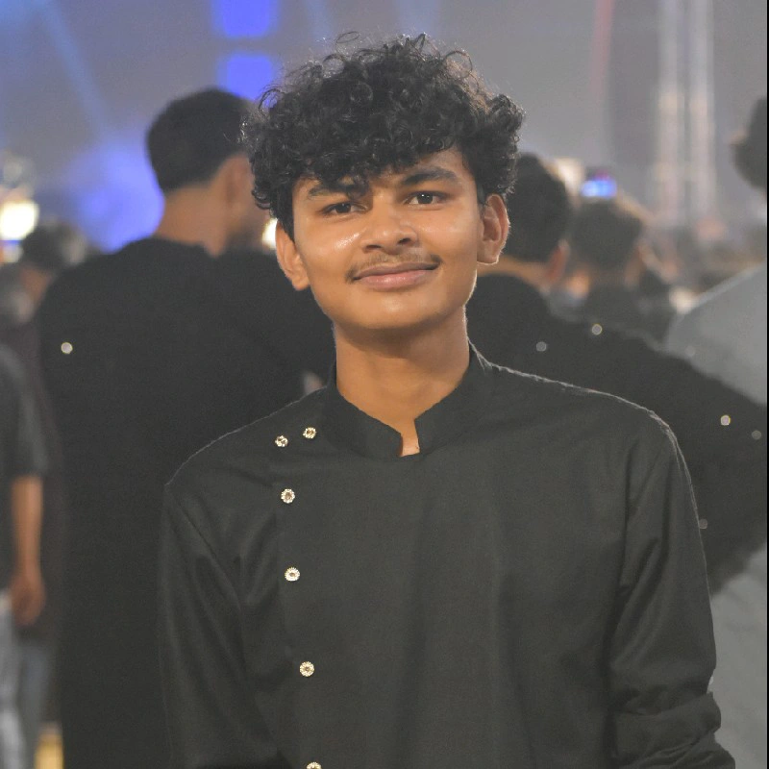
Project Tile – Interview Trainer Agent – AI-Powered Personalized Interview Preparation
Domain of Project – Education / Artificial Intelligence / Career Development
Student Name | Recent Passport Photo | Email ID | Mobile number [WhatsApp]
Nitin Saini |  | workbench@gmail.com | 8755762799

Slide 3
Problem Statement -
Problem Statement : Interview Trainer Agent
The Challenge : Job candidates often struggle to prepare effectively for interviews because interview questions, company expectations, technical requirements, and behavioral scenarios are scattered across multiple sources.
Generic interview-preparation platforms provide the same questions to everyone and often fail to consider a candidate's resume, experience level, target job role, and specific skills.
Candidates therefore need an intelligent system that can understand their profile, retrieve relevant interview knowledge, generate personalized questions, evaluate their responses, and provide actionable improvement suggestions.
Objective : 1. Profile-Based Personalization
2. RAG-Based Knowledge Retrieval
3. Personalized Question Generation
4. Answer Evaluation
5. Model Answers
6. Interview Strategy
Key Problems
Generic interview questions
Lack of personalized preparation
Difficulty identifying role-specific expectations
Scattered interview resources
Limited technical + HR preparation in one platform
Lack of personalized feedback
Difficulty improving weak answers
Low confidence before interviews

Slide 4
Proposed Solution -
Proposed Solution: Interview Trainer Agent is an AI-powered interview preparation platform that combines RAG + Agentic AI + IBM Granite to provide personalized interview preparation.
The user can upload their resume or enter a job role, after which the system analyzes the candidate profile and retrieves relevant interview knowledge.
The system then generates a customized interview session containing technical, behavioral, situational, and HR questions.
After the candidate answers, the AI evaluates the response and provides a score, feedback, model answer, and improvement tips.
Suggested workflow
User → Profile/Resume → Profile Agent → RAG Knowledge Retrieval → Question Generator → Interview Session → Answer Evaluation → Feedback → Preparation Strategy
Multi-Agent Architecture :
Agent 1 – Profile Analysis Agent
Agent 1 – Profile Analysis Agent
Agent 3 – Question Generator Agent
Agent 3 – Question Generator Agent
Agent 5 – Feedback & Improvement Agent
Agent 5 – Feedback & Improvement Agent

Slide 5
Technology Used
IBM Bob platform -For designing and orchestrating multi-agent workflows visually
IBM Grainte model - for eg – ibm-granite-3-2-8b – For natural language understanding, reasoning, and personalization
IBM Cloud – Used for:
Hosting/deployment
AI application infrastructure
Backend services
Scalable application environment

Slide 6
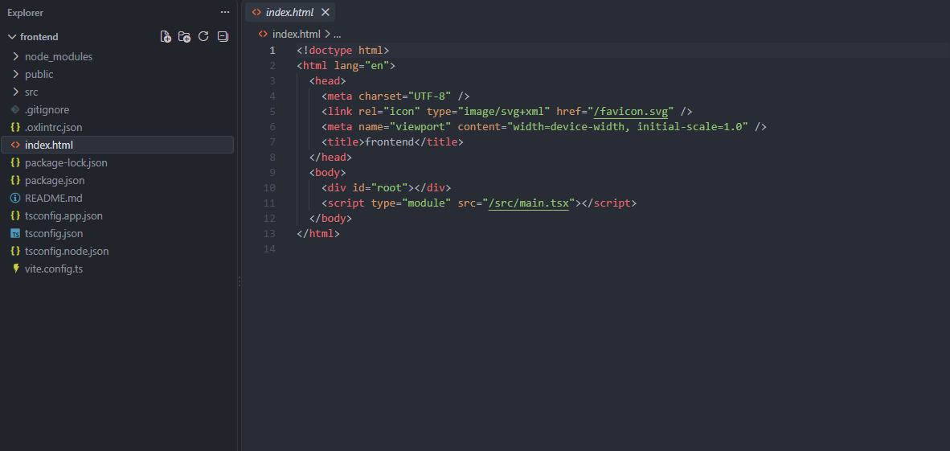
Required Files created using IBM bob -

Slide 7
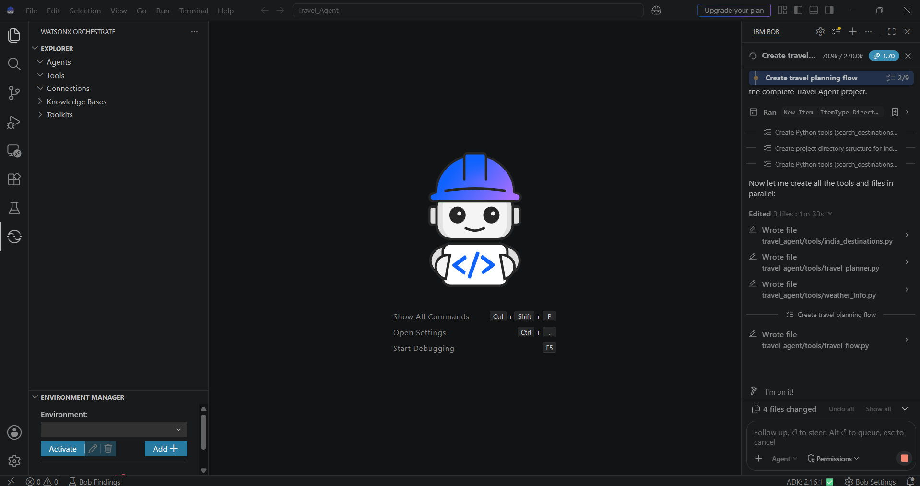
IBM Bob Screenshots:

Slide 8
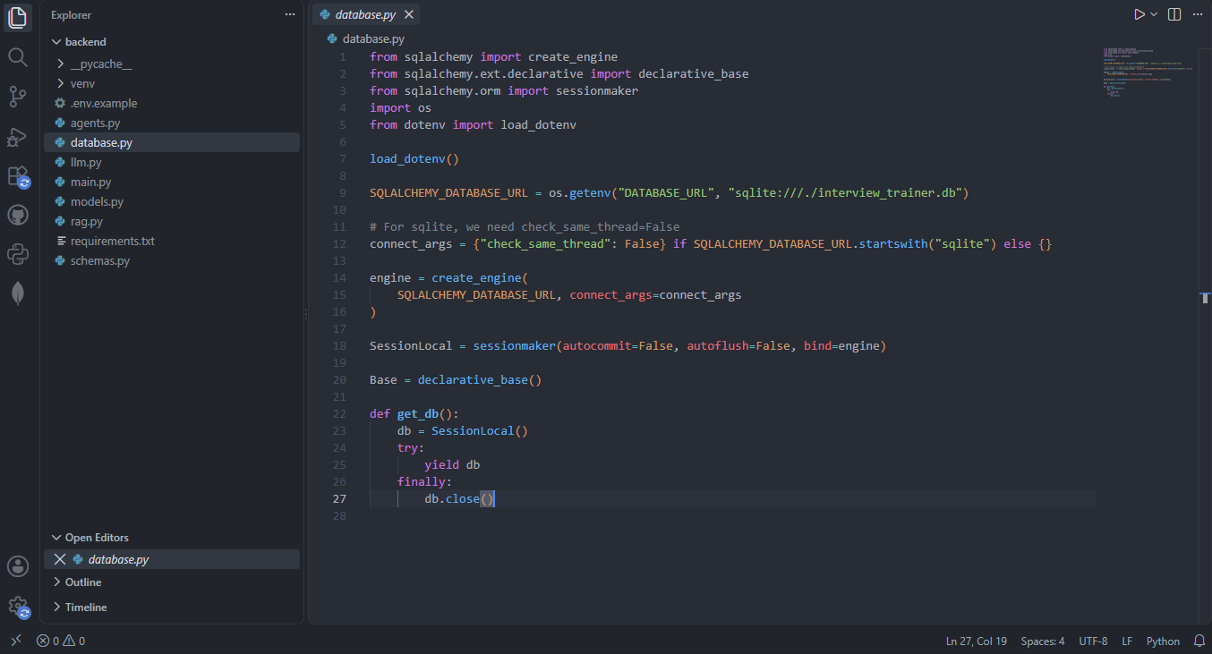

Slide 9
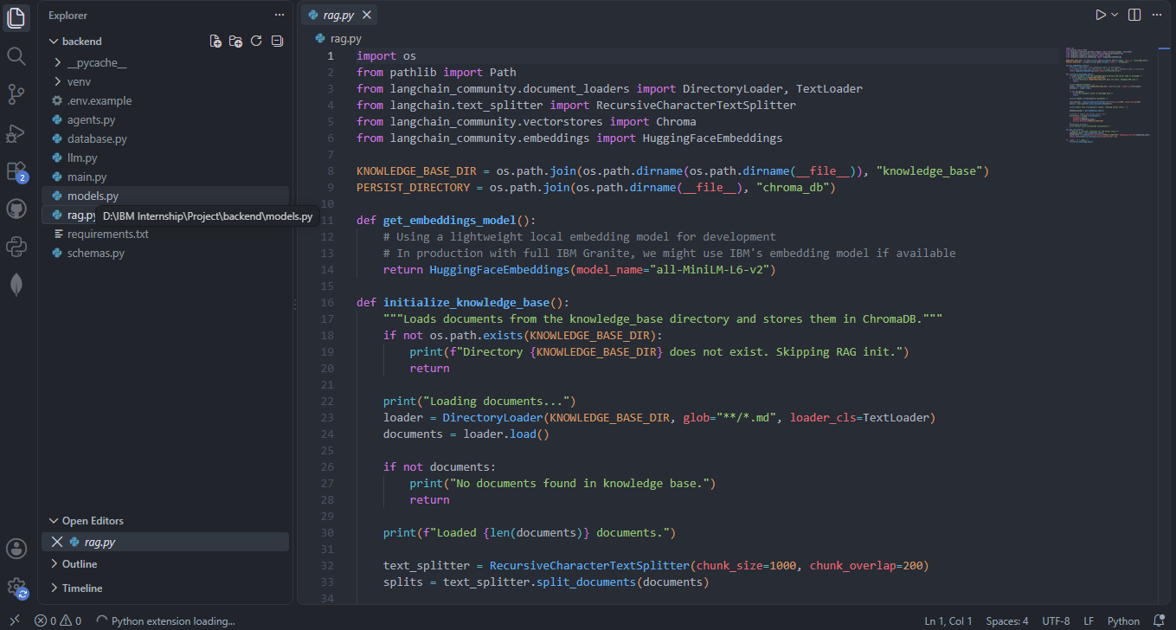

Slide 10
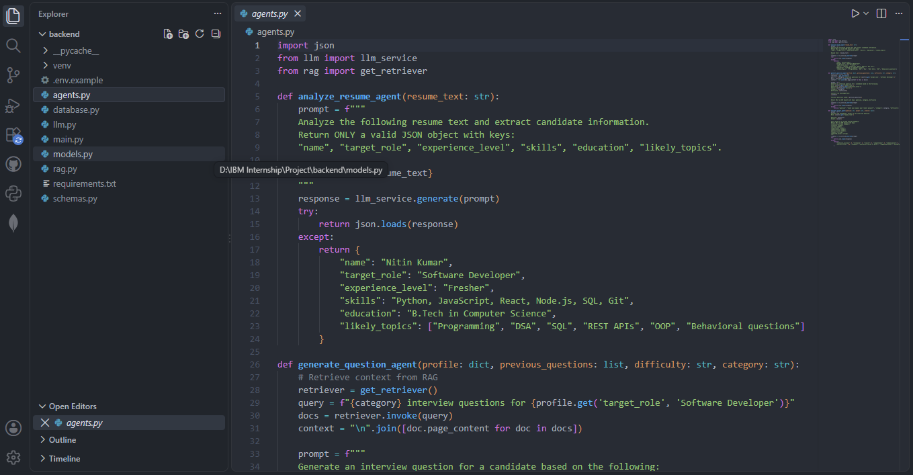

Slide 11
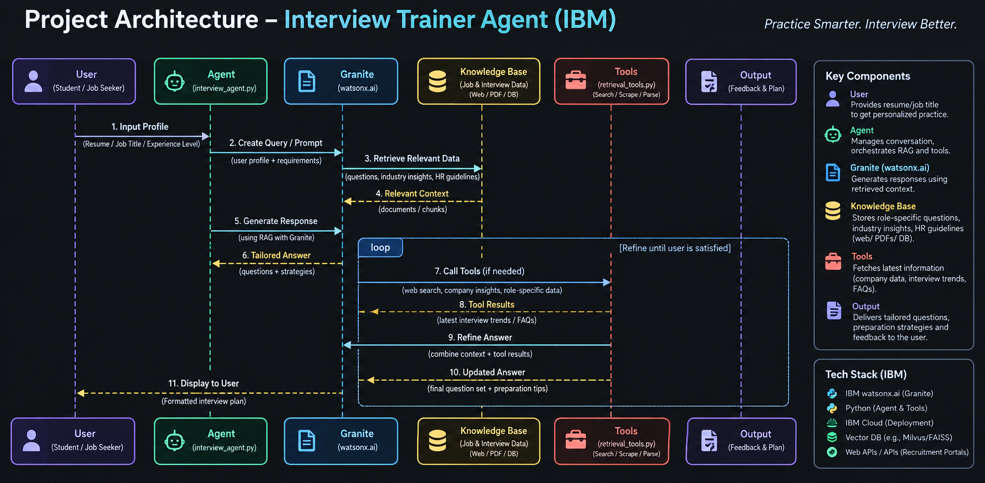
Architecture blueprint for IBM bob:

Slide 12

Role of Agentic AI in the solution
Role of Agentic AI in Nutrition Agent
Agentic AI enables the Nutrition Agent to function as an intelligent, autonomous system rather than a simple chatbot. Using IBM watsonx.ai and IBM Granite models, it coordinates multiple specialized agents to deliver personalized nutrition guidance.
Each agent performs a specific role—such as retrieving nutritional data, generating diet plans, providing health advice, and analyzing food logs—while working collaboratively. This multi-agent approach ensures efficient task execution and accurate results.
Agentic AI also brings context awareness, understanding user details like age, health conditions, and fitness goals to generate tailored recommendations. It supports real-time adaptation, continuously updating suggestions based on user inputs like daily meals.
Additionally, agents communicate with each other, enabling better decision-making and improved outcomes.
Overall, Agentic AI makes the system proactive, personalized, and goal-driven, acting like a smart digital nutritionist that helps users maintain a healthy lifestyle.

Slide 13
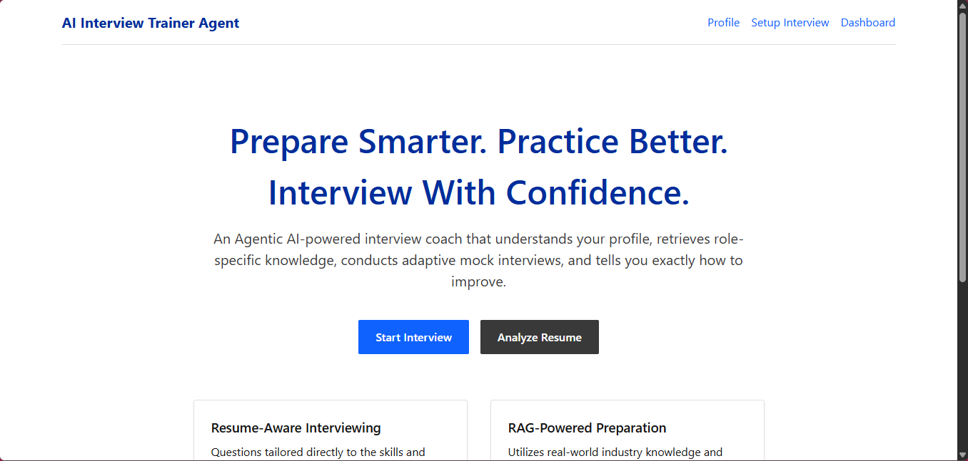
Project Output Screenshot
·
·
·

Slide 14
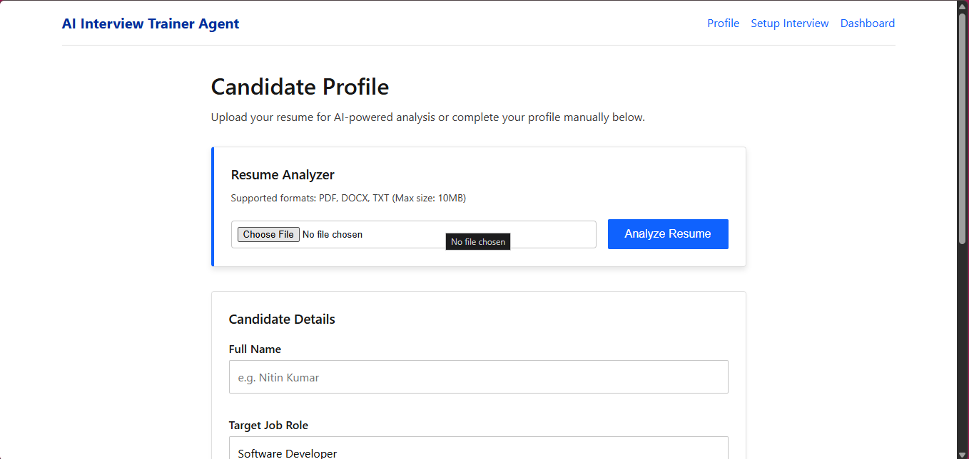
Project Output Screenshot
·
·
·

Slide 15
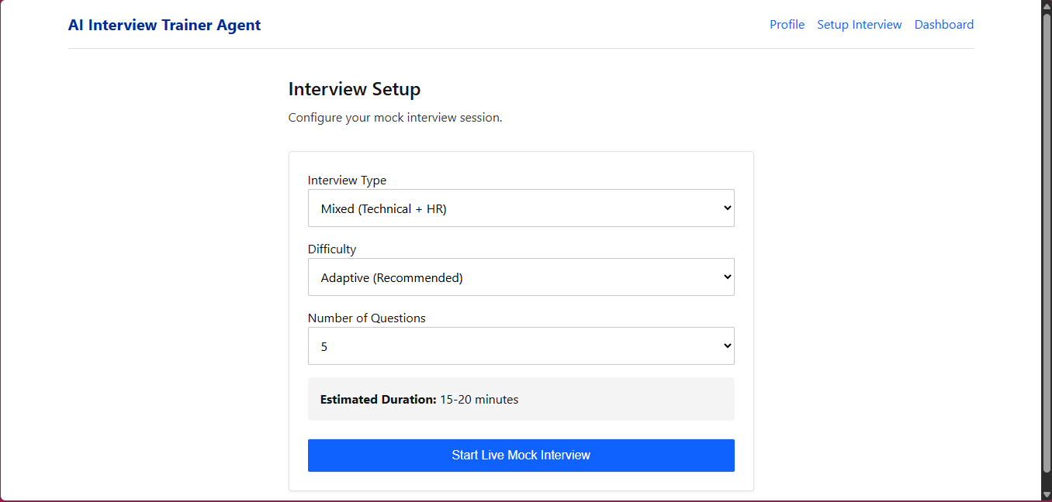
Project Output Screenshot
·
·
·

Slide 16
The Wow Factor Behind Our Project
Hyper-Personalized: Generates interview questions based on the candidate’s resume,
experience, skills, and target role.
RAG-Powered Intelligence: Retrieves relevant industry knowledge, interview patterns,
and HR guidelines to provide reliable responses.
Agentic Workflow: The AI can retrieve, analyze, use tools, and refine its responses
dynamically.
Role & Company Specific: Adapts preparation to the specific job role and company
requirements.
Complete AI Interview Coach: Provides questions, answer guidance, preparation
strategies, feedback, and improvement areas.
IBM Granite Powered: Uses IBM watsonx.ai & Granite to deliver intelligent,
context-aware interview preparation.
Continuous Refinement: Improves the preparation experience through an iterative
feedback and refinement loop.
·
·
·

Slide 17
Novelty and Uniqueness
Personalized Preparation: Goes beyond generic questions by adapting to the candidate’s resume, skills, experience, and target role.
RAG-Based Knowledge: Combines AI generation with retrieved, role-specific interview and industry information.
Agentic Decision-Making: The agent can decide what information or tools are needed before generating the final response.
Dynamic Refinement: Continuously refines questions and preparation strategies based on retrieved context and user interaction.
Real-World Relevance: Incorporates company, industry, and current interview trends instead of relying only on static question banks.
Beyond Q&A: Acts as an AI interview coach, providing preparation plans, strategies, feedback, and improvement areas.
IBM AI Integration: Demonstrates a practical combination of IBM watsonx.ai, Granite, RAG, and agentic AI in one solution.

Slide 18
Future Scope
AI Mock Interviews: Conduct realistic voice and video-based mock interviews with real-time interaction.
Performance Analytics: Track confidence, communication, technical accuracy, and improvement over multiple sessions.
Live Job Market Integration: Connect with job portals to provide current job requirements and skill trends.
Company-Specific Preparation: Generate preparation plans based on company interview patterns and hiring expectations.
Adaptive Learning: Automatically increase or decrease question difficulty based on the candidate’s performance.
Real-Time Feedback: Analyze answers and provide instant suggestions for better communication and responses.
Multi-Platform Expansion: Extend the solution to mobile and web platforms for anytime interview preparation.
Multilingual Support: Enable interview preparation in multiple languages for wider accessibility.
·
·
·

Slide 19
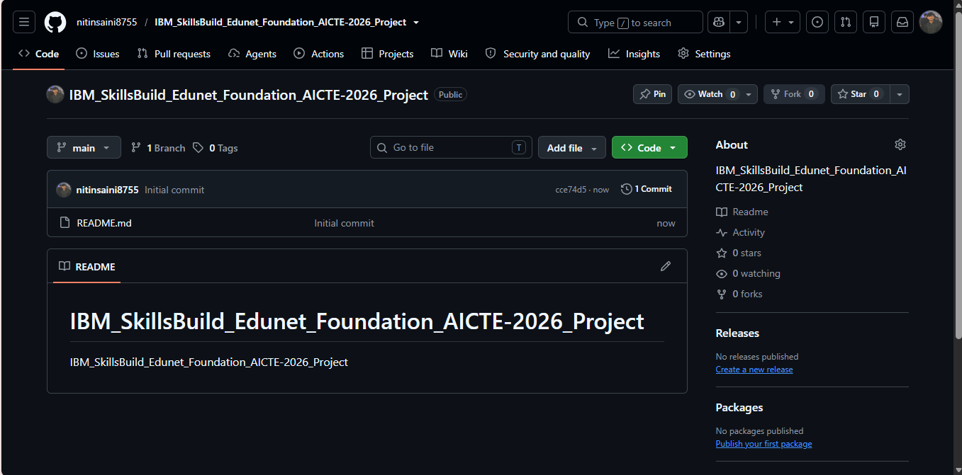
Git Hub Link
·
My GitHub Link nitinsaini8755/IBM_SkillsBuild_Edunet_Foundation_AICTE-2026_Project: IBM_SkillsBuild_Edunet_Foundation_AICTE-2026_Project
·
·
·

Slide 20
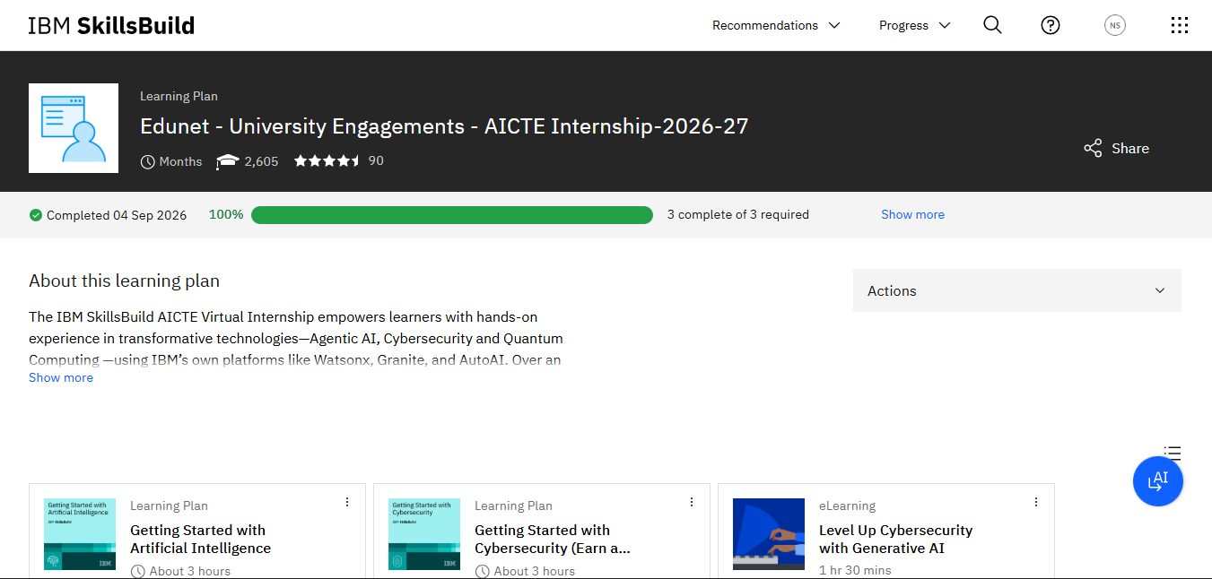
Skills build profile screen shot

Slide 21
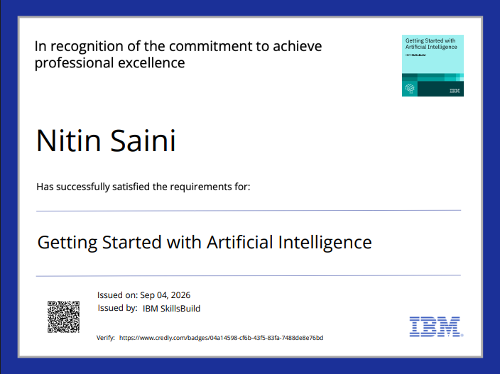
Certificates Earned:
Please add your credly certificate(Getting Started with Artificial Intelligence)

Slide 22
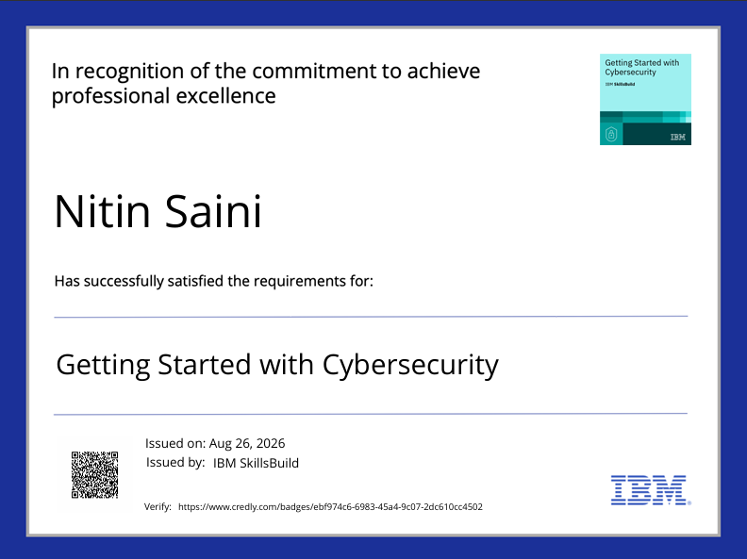
Certificates Earned:
Please add your credly certificate(Getting Started with Cybersecurity)

Slide 23
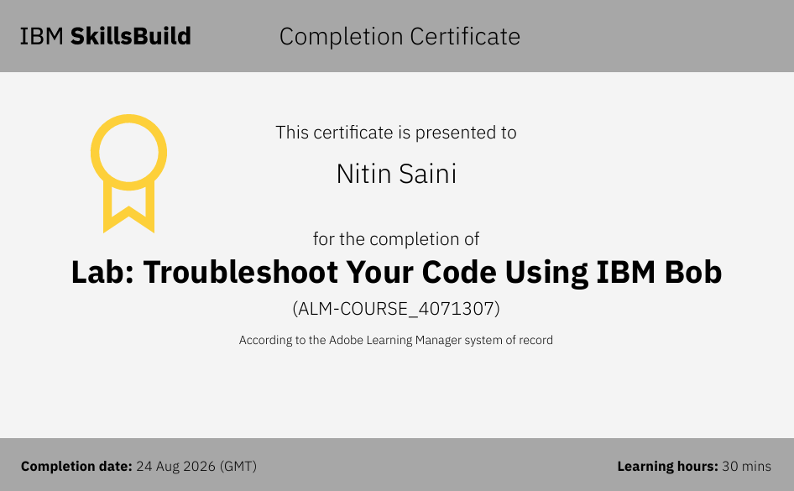
Certificates Earned:​
Add your IBM BOB Certificate

Slide 24


